Slide 1
Cloud Computing Resources, Grants, and Datasets
BD2K 2018 Workshop in Farmington

Slide 2
Today
Research Computing Grants
XSEDE
AWS, Google, Azure
Public Datasets
Challenges

Slide 3

NSF XSEDE Program
Originally a five-year, $121-million NSF-supported project in 2011 – XSEDE 2.0 funded in August 2016 for an additional five-years with $110-million
16 supercomputers and other high-end visualization and data analysis resources around the country are supported
XSEDE Allocations are Zero-Cost (FREE) to the end user
XSEDE is the most advanced, powerful and robust collection of integrated advanced digital resources in the world. It is a single virtual system that scientists can use to interactively share computing resources, data, and expertise.
xsede.org
Credit: JAX IT Architecture Lunch - Shane Sanders
xsede.org/resources/overview
Notes:
Credit: IT Architecture Lunch - Shane Sanders
XSEDE Flyer: https://www.xsede.org/documents/10157/169907/WhatIsXSEDE_flyer2012.pdf%20

Slide 4
XSEDE Allocation Types
Trial – rapid, but limited access to XSEDE resources
Campus Champions – helps XSEDE Campus Champions get potential researchers familiar with XSEDE resources
Startup – small, available for 1 year, after 1 year a Research allocation has to be requested
Education – training or academic classes with specific start and end dates
Research – full allocations, reviewed and awarded quarterly, merit based
Notes:
Credit: IT Architecture Lunch - Shane Sanders
https://portal.xsede.org/knowledge-base/-/kb/document/anql
https://www.xsede.org/documents/10157/169907/WhatIsXSEDE_flyer2012.pdf%20

Slide 5
XSEDE Allocation
Research Allocation Proposals:
The research is summarized in context of the current state of the art; outlines the computational algorithms to be used; and relates those algorithms to subsections of the request.
Provide sufficient information, without overwhelming details to the reviewers.
The justification for the request is clear, and closely coupled to computational experiments and needs, so that if the committee needs to reduce the original request, it can be done rationally with minimum disruption to the investigator.
Summarize results from relevant previous allocations, including manuscripts published, accepted, submitted, or in preparation, and relate these results to the current request.
Notes:
Credit: IT Architecture Lunch - Shane Sanders

Slide 6
XSEDE Science Gateways
Currently 33 XSEDE Science Gateways that provide web-portal interaction with XSEDE computational resources.
Some Gateways relevant to the researchers:
Biodrugscore: A portal for customized scoring and ranking of molecules docked to the human proteome
The CyVerse Collaborative Agave API
IntegromeDE: Integrated database and search engine for systems biology
ROBETTA: Automated Prediction of Protein Structure Interactions
Neuroscience Gateway
CIPRES: Portal for inference of large phylogenetic trees
Computational Anatomy Gateway – image processing, visualization, and graphics
https://www.xsede.org/ecosystem/science-gateways/gateways-listing
Notes:
Gateway domains include: Advanced Scientific Computing, Anthropology, Astronomy, Atmospheric Sciences, Biochemistry, Biophysics, Chemistry, Communications, Earth Sciences, Earthquake Hazard Mitigation, Particle Physics, Materials Research, Visualization and Image Processing, Neuroscience, Molecular Biosciences
Credit: IT Architecture Lunch - Shane Sanders

Slide 7
XSEDE Campus Champions
The XSEDE Campus Champions program supports campus representatives as a local source of knowledge about high-performance and high-throughput discovery.
Campus Champions serve as a:
Source of local, regional and national high-performance computing and cyberinfrastructure information
Source of information regarding XSEDE resources and services that will benefit research and education
Source of start-up accounts on your campus to quickly get researchers and educators using their allocations of time on XSEDE resources
Conduit for the campus high-performance computing needs, requirements and challenges, with direct access to XSEDE staff
https://www.xsede.org/web/campus-champions
Credit: IT Architecture Lunch - Shane Sanders
Notes:
Credit: IT Architecture Lunch - Shane Sanders

Slide 8
XSEDE Extended Collaborative Support Services
XSEDE ECSS provides XSEDE users with access to cyberinfrastructure experts with a variety of expertise, and these experts are available for collaborations lasting months to a year to help users utilize their XSEDE resources.
ECSS has expertise in a range of areas:
Performance Analysis
Petascale Optimization
Coprocessor / GPU Acceleration
I/O Optimization
Data Analytics
Visualization
ECSS support can be requested through the standard XSEDE allocation request process.
Credit: IT Architecture Lunch - Shane Sanders

Slide 9
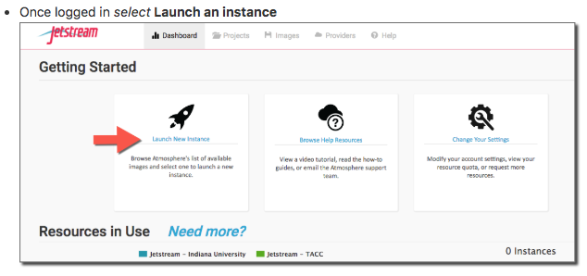
XSEDE Jetstream
Galaxy on Jetstream
Apply for their own Startup and Research Allocations
Jetstream Cloud: jetstream-cloud.org/
Galaxy on Jetstream: galaxyproject.org/cloud/jetstream/
Allocations: portal.xsede.org/allocations-overview#types-startup
Thanks to Shane Sanders for providing all the XSEDE information.

Slide 10
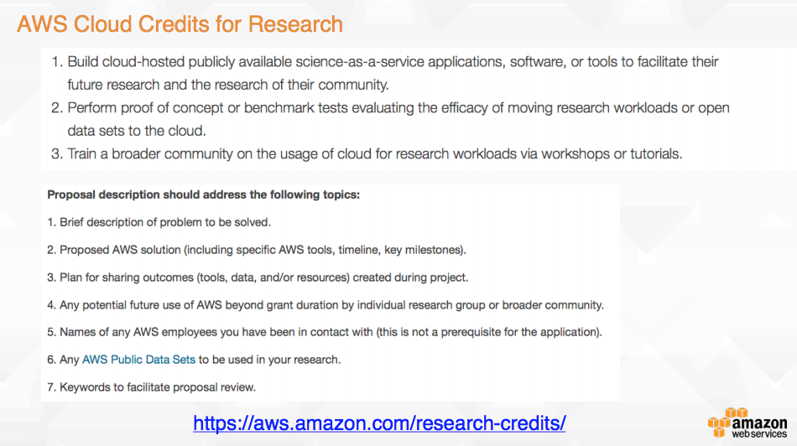
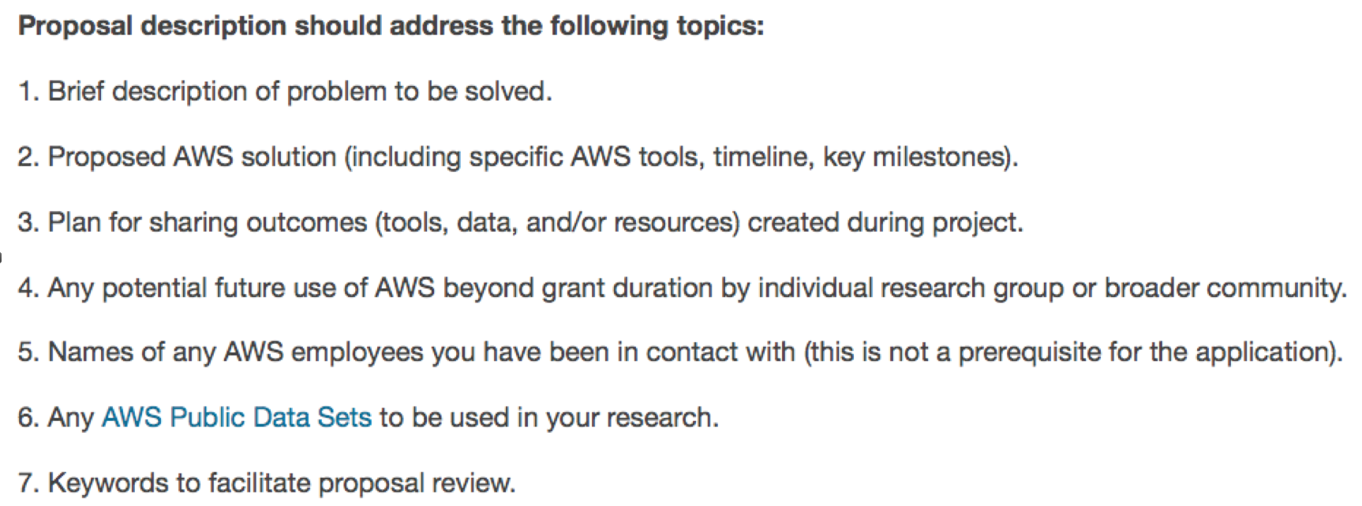

AWS Cloud Credits for Research Program
AWS provides free credits to reseachers:
Build application useful to scientific community
Proof of concept projects
Provide training
Slide from AWS Research Initiatives - Sanjay Padhi

Slide 11
Microsoft Azure for Research awards
Provides researchers with Azure credits
Good for initial proof of concept projects
Azure for Research Award: Data Science
Learn more at: microsoft.com/en-us/research/academic-program/microsoft-azure-for-research/
Proposal submission: azure4research.azurewebsites.net
Data Science Award: microsoft.com/en-us/research/academic-program/data-science-award/

Slide 12
Google Cloud Research Credits Program
GCP credits can be used for any computing services on Google Cloud Platform such as storage, compute, and data analysis.
Awards are worth $5,000 (USD) in GCP credits
Blogpost: https://www.blog.google/topics/google-cloud/google-cloud-platform-announces-new-credits-program-researchers/
Application Form: https://lp.google-mkto.com/gcp-research-credits.html

Slide 13
Google Research Awards
Google Faculty Research Award
A Google employee must champion the proposal.
Seed funding to support research
Google Cloud Platform Education Grants for computer science
Teachers and faculty at universities which are regionally accredited
Google faculty research awards: research.google.com/research-outreach.html#/research-outreach/faculty-engagement/faculty-research-awards
TensorFlow Research Cloud: https://www.tensorflow.org/tfrc/

Slide 14
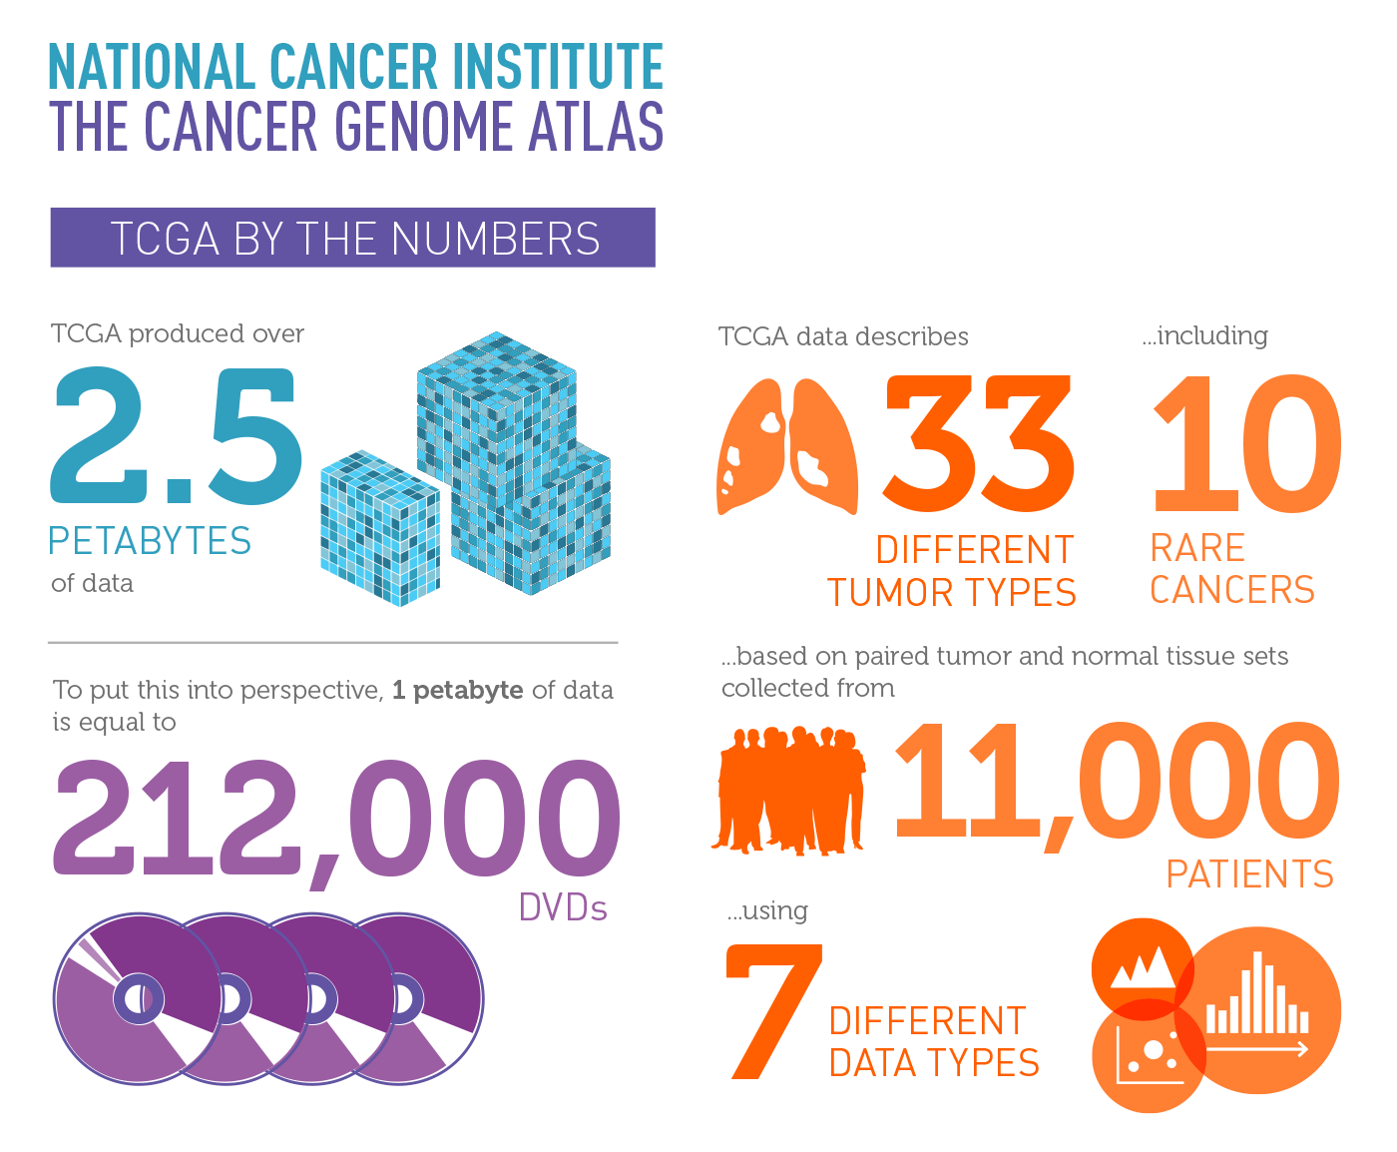
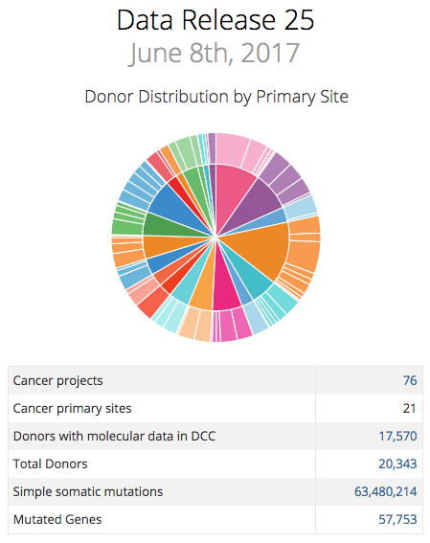
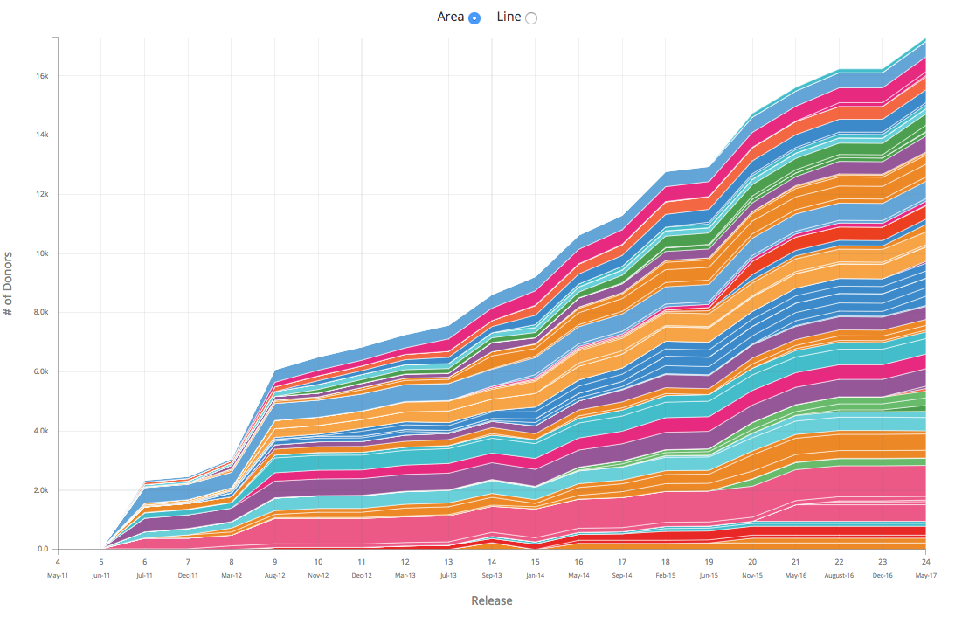
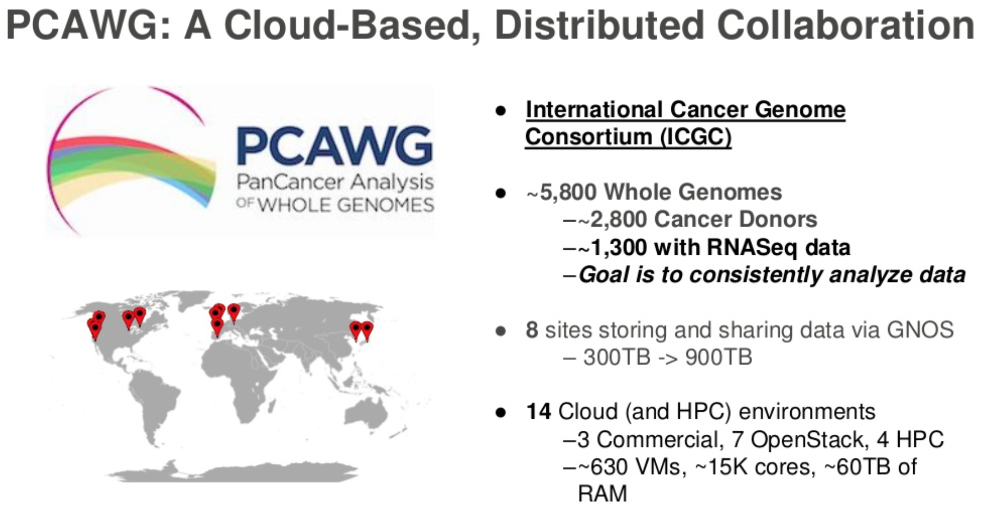
Big Genomics Datasets
ICGC Dataset
Slide from AWS re:Invent 2016: Large-Scale, Cloud-Based Analysis of Cancer Genomes: Lessons Learned from the PCAWG Project (LFS304). Credit: Brian O’Connor
https://dcc.icgc.org/
http://docs.icgc.org/pcawg/
https://portal.gdc.cancer.gov/

Slide 15
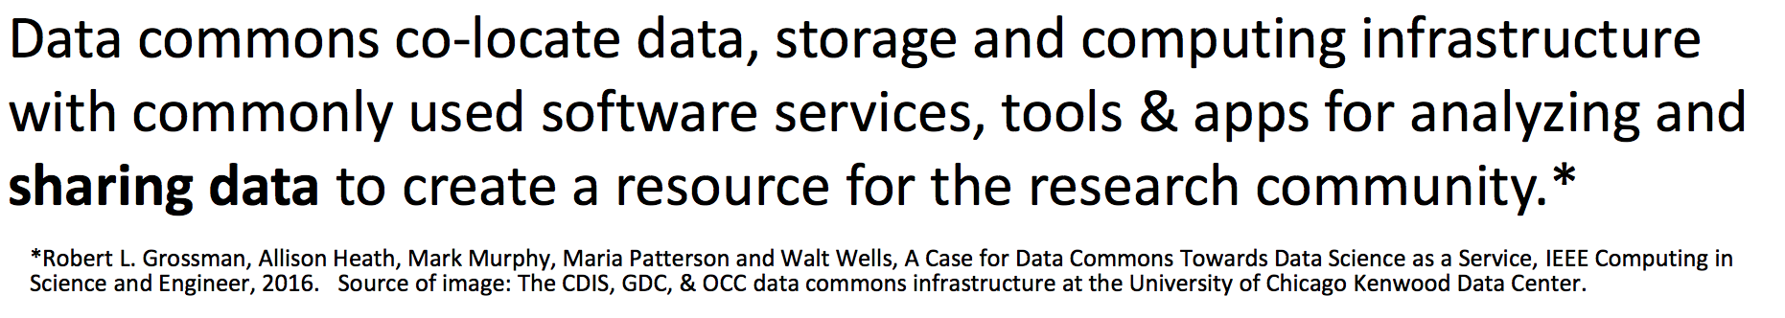
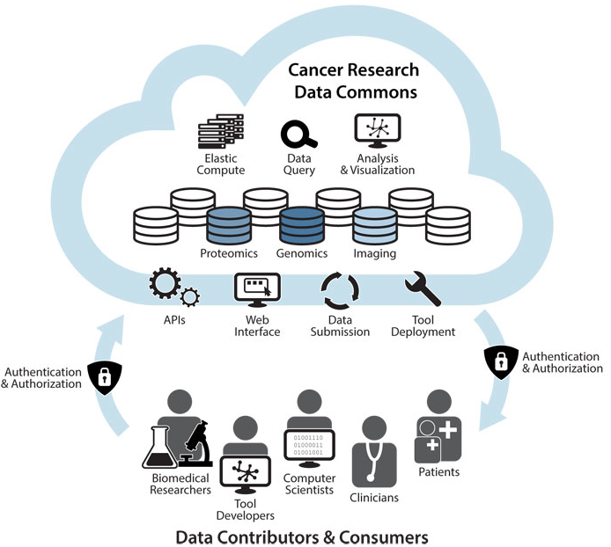
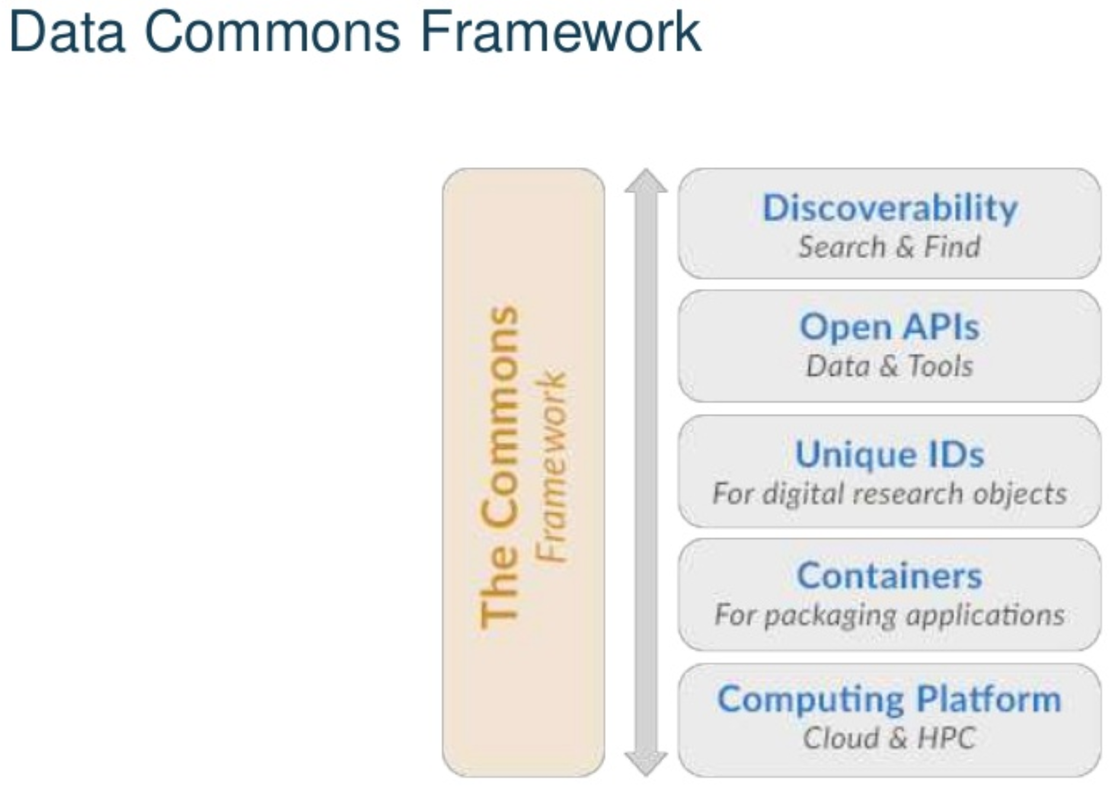
Data Commons
Presentation by Warren Kibbe: Precision Medicine in the Age of NCI MATCH and the Beau Biden Cancer Moonshot
Notes:
Co-localize the compute and the data in order to do the computation
Portable tools – tool containers
Provide harmonized genomics data
Provide secure access of data and scalable compute
Software , metadata, tools, annotation
GA4GH initiative
Data Lakes
ICGC – PCAWG project
TCGA
Data Sharing architectures
support open data science
support data reusabilty

Slide 16


Challenges
Reproducibility of the analysis
Management of resources, cloud costs and budgeting
Data transfer rate remains a bottleneck
Estimating costs
Networking problems - 1GB and 10 GB
Cloud vs On-Premise
High level of programming expertise
Researchers are not IT experts
A big learning curve
Jargon used by each provider
IT security, Legal and data security/privacy
Controlled, Clinical, and HIPPA data
Notes:
TCO calculator
Operation not part of curriculum, rate of innovation

Slide 17
Resources
NCI Pilot handout
https://cbiit.nci.nih.gov/sites/nci-cbiit/files/Cloud_Pilot_Handout_508compliant.pdf
Google Public Datasets
https://cloud.google.com/public-datasets/
AWS HPC
https://aws.amazon.com/hpc/
Google Genomics
https://cloud.google.com/genomics/
XSEDE Jetstream cloud platform
http://research-it.berkeley.edu/blog/17/02/17/jetstream-cloud-support-multi-institutional-data-science-workshops-and-research
Google Codelabs
XSEDE Flyer:
https://www.xsede.org/documents/10157/169907/WhatIsXSEDE_flyer2012.pdf%20

Slide 18
Resources
AWS pricing calculator
https://calculator.s3.amazonaws.com/index.html
Microsoft Azure Pricing Calculator
https://azure.microsoft.com/en-us/pricing/calculator/
Google Pricing Calculator
https://cloud.google.com/products/calculator/
Data Egress Waivers
https://azure.microsoft.com/en-us/blog/azure-egress-fee-waiver-for-the-academic-community/
https://aws.amazon.com/blogs/publicsector/aws-offers-data-egress-discount-to-researchers/
Total cost of ownership calculators
https://aws.amazon.com/tco-calculator/
https://azure.microsoft.com/en-us/pricing/tco/calculator/
Notes:
TCO:
Consider https://www.forbes.com/sites/moorinsights/2016/04/11/tco-analysis-demonstrates-how-moving-to-the-cloud-can-save-your-company-money/#4dc54a587c4e
Capital expenses: On-premises hardware & software
Operating expenses: Services, support & maintenance fees to keep the equipment running
Indirect costs: Potential downtime and time-to-market delays

Slide 19
Resources
Research & Technical Computing on AWS
https://aws.amazon.com/government-education/research-and-technical-computing/
AWS Research Cloud Program
https://aws.amazon.com/government-education/research-and-technical-computing/research-cloud-program/
AWS Educate
https://aws.amazon.com/education/awseducate/
Google Cloud Platform Education Grants
https://cloud.google.com/edu/
Global Alliance for Genomics and Health
http://genomicsandhealth.org/
Galaxy Capacity Planning
https://galaxyproject.org/cloudman/capacity-planning/
Teaching Cloud Computing
https://ieeexplore.ieee.org/document/7562336/

Slide 20
Thank you

Slide 21
AWS Public Datasets
1000 Genomes Project: A detailed map of human genetic variation.
TCGA on AWS: Raw and processed genomic, transcriptomic, and epigenomic data from The Cancer Genome Atlas (TCGA) available to qualified researchers via the Cancer Genomics Cloud.
ICGC on AWS: Whole genome sequence data available to qualified researchers via The International Cancer Genome Consortium (ICGC).
3000 Rice Genome on AWS: Genome sequence of 3,024 rice varieties.
Genome in a Bottle (GIAB): Several reference genomes to enable translation of whole human genome sequencing to clinical practice.
aws.amazon.com/public-datasets/

Slide 22
Google Public Datasets
Reference Genomes: Reference Genomes such as GRCh37, GRCh37lite, GRCh38, hg19, hs37d5, and b37.
Illumina Platinum Genomes: This dataset comprises the 17 member CEPH pedigree 1463.
Personal Genome Project Data: This dataset comprises roughly 180 Complete Genomics genomes.
ICGC-TCGA DREAM Mutation Calling Challenge synthetic genomes: This dataset comprises the three public synthetic tumor/normal pairs created for the ICGC-TCGA DREAM Mutation Calling challenge.
Simons Genome Diversity Project: This dataset comprises 25 genomes from 13 diverse populations serving as the pilot project dataset
TCGA Cancer Genomics Data in the Cloud: Open-access TCGA data including somatic mutation calls, clinical data, mRNA and miRNA expression, DNA methylation and protein expression from 33 different tumor types.
cloud.google.com/public-datasets/

Slide 23
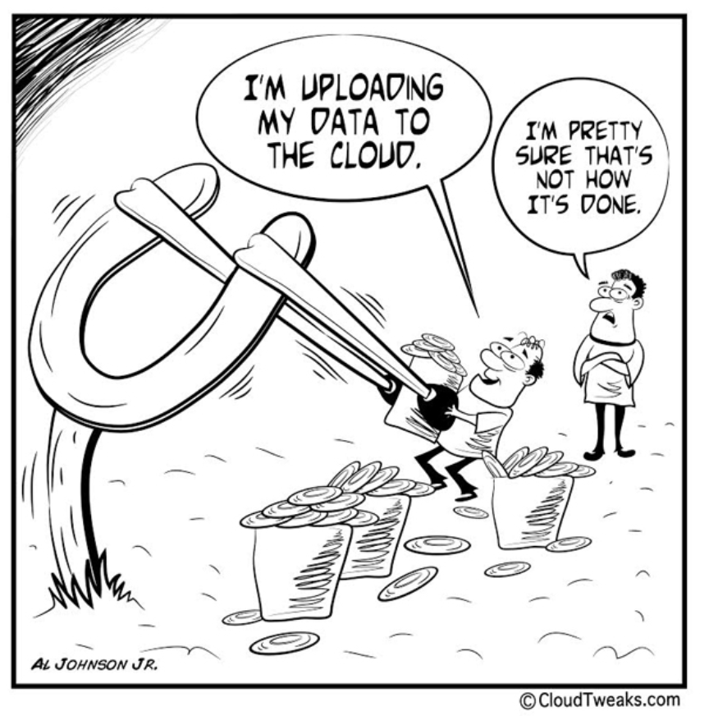

Slide 24
Into the future..
Machine Learning, Deep learning, and AI
Highly distributed, scalable systems
Edge computing
Highly interconnected networks
Software defined architectures
New programming languages
➔ Build a rich ecosystem for collaboration among researchers
Notes:
Machine Learning:
Extract learning, continuous training and data, deep leaning - accuracy
VR headsets
software + hardware
Edge computing:
What is cloud - a place where learning occurs
Current: Solution = ML expertise + data + computation
Can we turn this into: Solution = data + 100X computation
- Build standards

Slide 25
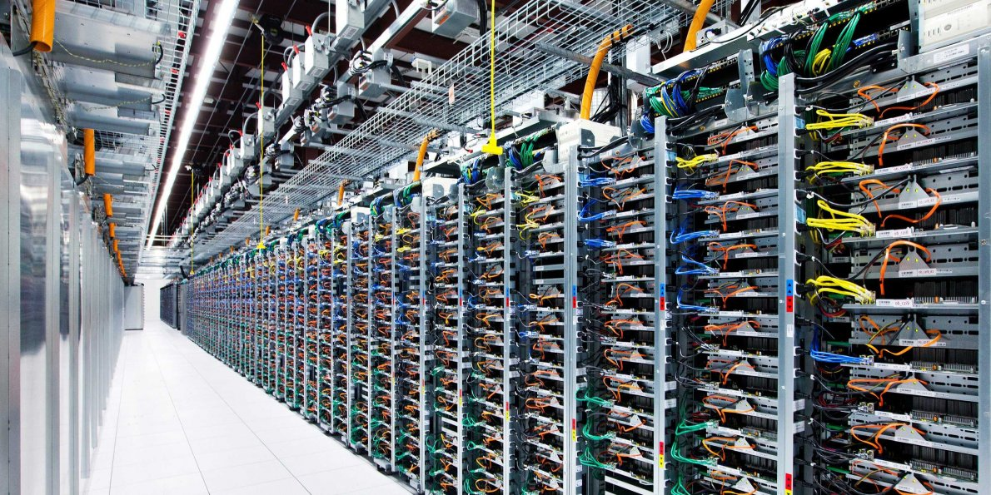
Google Data Centers

Slide 26
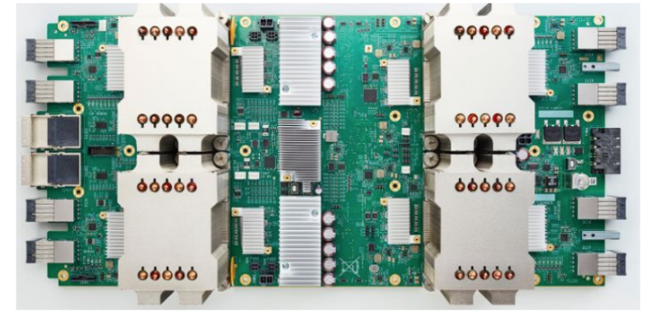
Google TPU
180 teraflops
Designed for ML training and prediction

Slide 27
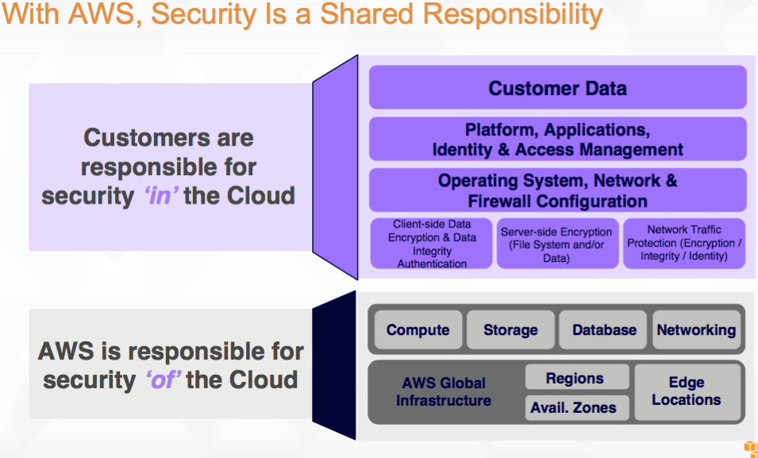

Slide 28
Current JAX Campus Champion Allocations:
System | Allocation (SUs)
Gordon | 50,000
OSG | 200,000
Stampede | 50,000
Maverick | 3,000
SuperMIC | 50,000
Comet | 50,000
Jetstream | 50,000
Bridges | 2,500
Xstream | 3,000
Thanks to Shane Sanders for providing all the XSEDE information.

Slide 29
XSEDE Allocations Overview
All allocations are for a period of 1 year.
Computational Resources: XSEDE SPs offer a variety of high-performance computing (HPC) and high-throughput computing systems for allocation. Computing platforms include clusters, scalable-parallel systems, and shared-memory systems with various CPU, memory, communication, and storage configurations.
Visualization Resources: SPs provide a variety of visualization resources and software services to the XSEDE user community. These systems provide a powerful way to interact with and analyze data at any scale.
Storage Resources: Several XSEDE SPs host storage platforms providing services such as data management, data collections hosting, and large-scale persistent storage. Data cannot be controlled access or HIPPA or PHI data.
Example allocation requests: portal.xsede.org/allocations/research
Notes:
Credit: IT Architecture Lunch - Shane Sanders

